Slide 1

FACE RECOGNITION CLASSROOM BASED ATTENDANCE SYSTEM USING PYTHON AND AI
TEAM MEMBER
AJAY KUMAR (310519104008)
AJAY KUMAR (310519104009)
KAMLESH KUMAR KOHLI (310519104054)
KRISHNA KUMAR (310519104058)
Guided By
MR. M.V. PRABHAKRAN
(M.E ASSISTANT PROFESSOR SUPERVISOR)
DHANALAKSHMI SRINIVASAN COLLEGE OF ENGINEERING AND TECHNOLOGY DEPARTMENT OF CSE

Slide 2
ABSTRACT
The main purpose of this project is to build a face recognition-based attendance monitoring system for educational institution to enhance and upgrade the current attendance system into more efficient and effective as compared to before.
The current old system has a lot of ambiguity that caused inaccurate and inefficient of attendance taking.
The human face is one of the natural traits that can uniquely identify an individual.
Therefore, it is used to trace identity as the possibilities for a face to deviate or being duplicated is low.
In this project, face databases will be created to pump data into the recognizer algorithm. Then, during the attendance taking session, faces will be compared against the database to seek for identity.
When an individual is identified, its attendance will be taken down automatically saving necessary information into a excel sheet.
DHANALAKSHMI SRINIVASAN COLLEGE OF ENGINEERING AND TECHNOLOGY DEPARTMENT OF CSE

Slide 3
EXISTING SYSTEM
Algorithms
Recognize and manipulate faces from Python or from the command line with the world’s simplest face recognition library.
Built using dlib’s state-of-the-art face recognition built with deep learning.
The model has an accuracy of 99.38% on the Labelled Faces in the Wild benchmark.
This also provides a simple face_recognition command line tool that lets you do face recognition on a folder of images from the command line!
Drawbacks
Materials like metal & liquid can impact signal.
Sometimes not as accurate or reliable as barcode scanners.
DHANALAKSHMI SRINIVASAN COLLEGE OF ENGINEERING AND TECHNOLOGY DEPARTMENT OF CSE

Slide 4
PROPOSED SYSTEM
Algorithm
We proposed the new methodologies for an automated attendance system using video-based face recognition.
Here input to the system is a video and output is an excel sheet with attendance of the students in the video.
If it is a valid match then attendance is registered to an excel sheet.
Advantages
The database of the attendance management system can hold up to 2000 individual‟s information.
PyAttendance can take multiple faces at a single time
An excel sheet is created which contains the student attendance and is mailed to the respected faculty
DHANALAKSHMI SRINIVASAN COLLEGE OF ENGINEERING AND TECHNOLOGY DEPARTMENT OF CSE

Slide 5
Literature Survey
[1] Real-Time Smart Attendance System using Face Recognition Techniques
With this Literature survey we are use real time attendance as Live Video detection
The system showcases the ability to track attendance in real-time, providing immediate and up-to-date information about who is present.
By using face recognition in real-time, the system provides immediate visibility into students' attendance status, enabling prompt intervention if needed.
[2] Student Attendance System using Face Recognition :
Efficient Attendance Tracking :The system demonstrates how face recognition technology can streamline attendance tracking for students, eliminating the need for manual processes.
[3] Face Recognition Based Smart Attendance System y
Scalability: The system's design allows for scalability to accommodate a large number of students across multiple classrooms or educational institutions.
Biometric Security :The system utilizes biometric authentication through facial features, enhancing security by ensuring that attendance is marked by the actual individuals.
DHANALAKSHMI SRINIVASAN COLLEGE OF ENGINEERING AND TECHNOLOGY DEPARTMENT OF CSE

Slide 6
Literature Survey
[4] Face Recognition Attendance System Based on Real-Time Video Processing :
Privacy and Consent : Implementing a face recognition system necessitates addressing privacy concerns and obtaining appropriate consent from individuals whose data is being collected
[5] Automatic Attendance System using Face Recognition :
Automation and Efficiency :The system demonstrates the automation of attendance tracking using face recognition, leading to increased efficiency and reduced manual effort.
[6] AttenFace: A Real Time Attendance System Using Face Recognition :
Improved Accountability :The system enhances accountability by providing a digital record of attendance that is difficult to manipulate or falsify.
Time Savings : By automating attendance tracking, the system saves time for both individuals marking attendance and administrative staff managing attendance records.
DHANALAKSHMI SRINIVASAN COLLEGE OF ENGINEERING AND TECHNOLOGY DEPARTMENT OF CSE

Slide 7
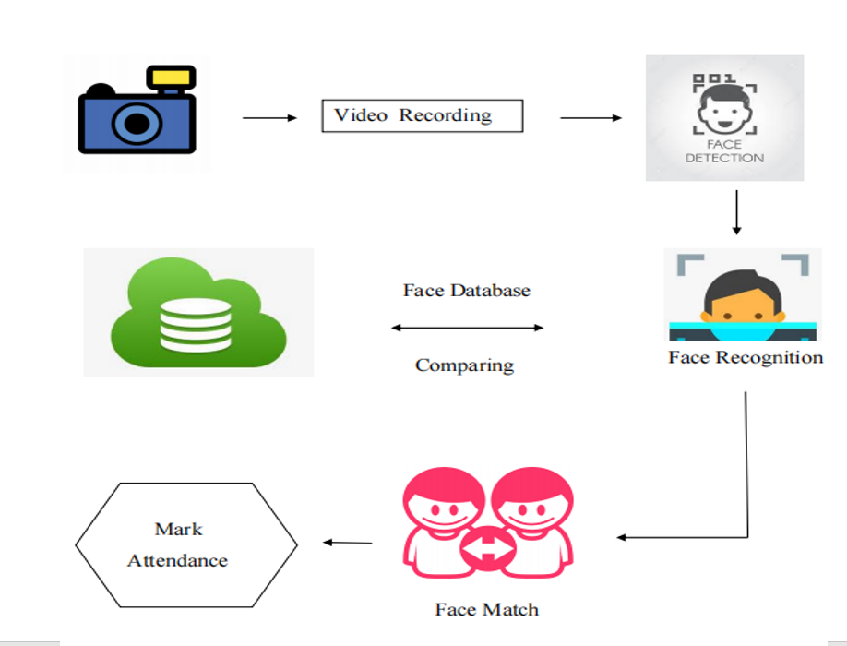
SYSTEM ARCHITECTURE
DHANALAKSHMI SRINIVASAN COLLEGE OF ENGINEERING AND TECHNOLOGY DEPARTMENT OF CSE

Slide 8
MODULES
Creating database
The database is the training set of our system and is created in such a way that it contains images of enrolled students.
Video recording
We must have a very good quality camera to get the efficient detection and recognition. It will capture the video. The video into convert the multiple frames. It will helpful for more accurate to produce the results.
Face Detection
We are train the collected video frames using Deep leaning techniques. Because, it will train to multiple times and push a very fast results.
DHANALAKSHMI SRINIVASAN COLLEGE OF ENGINEERING AND TECHNOLOGY DEPARTMENT OF CSE

Slide 9
MODULES
Face Recognition
This is the most important module of our system which is used to perform the comparison between the test images and the training images.
Faces are made of thousands of fine lines and features that must be matched.
Registering the attendance
After completion of the face recognition module, next comes the module to register the attendance. If the detected face has been recognized, then it marks the attendance in the excel sheet.
If the detected face has been recognized, then it marks the attendance in the excel sheet.
DHANALAKSHMI SRINIVASAN COLLEGE OF ENGINEERING AND TECHNOLOGY DEPARTMENT OF CSE

Slide 10
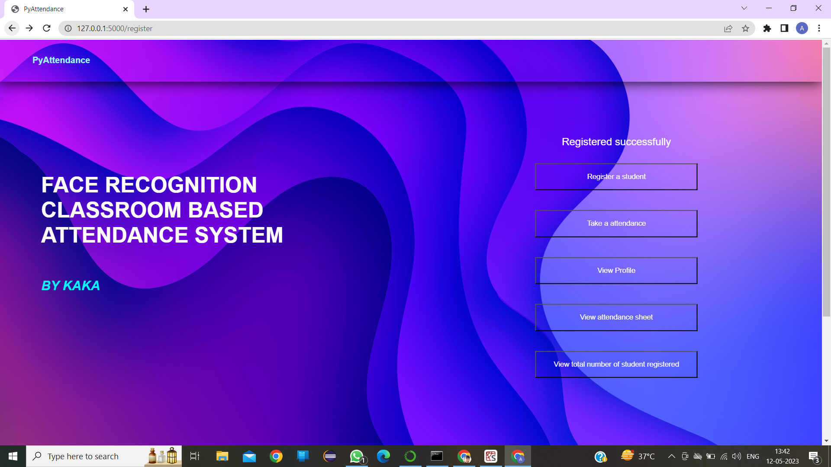
SCREENSHOTS
HOME PAGE
DHANALAKSHMI SRINIVASAN COLLEGE OF ENGINEERING AND TECHNOLOGY DEPARTMENT OF CSE

Slide 11
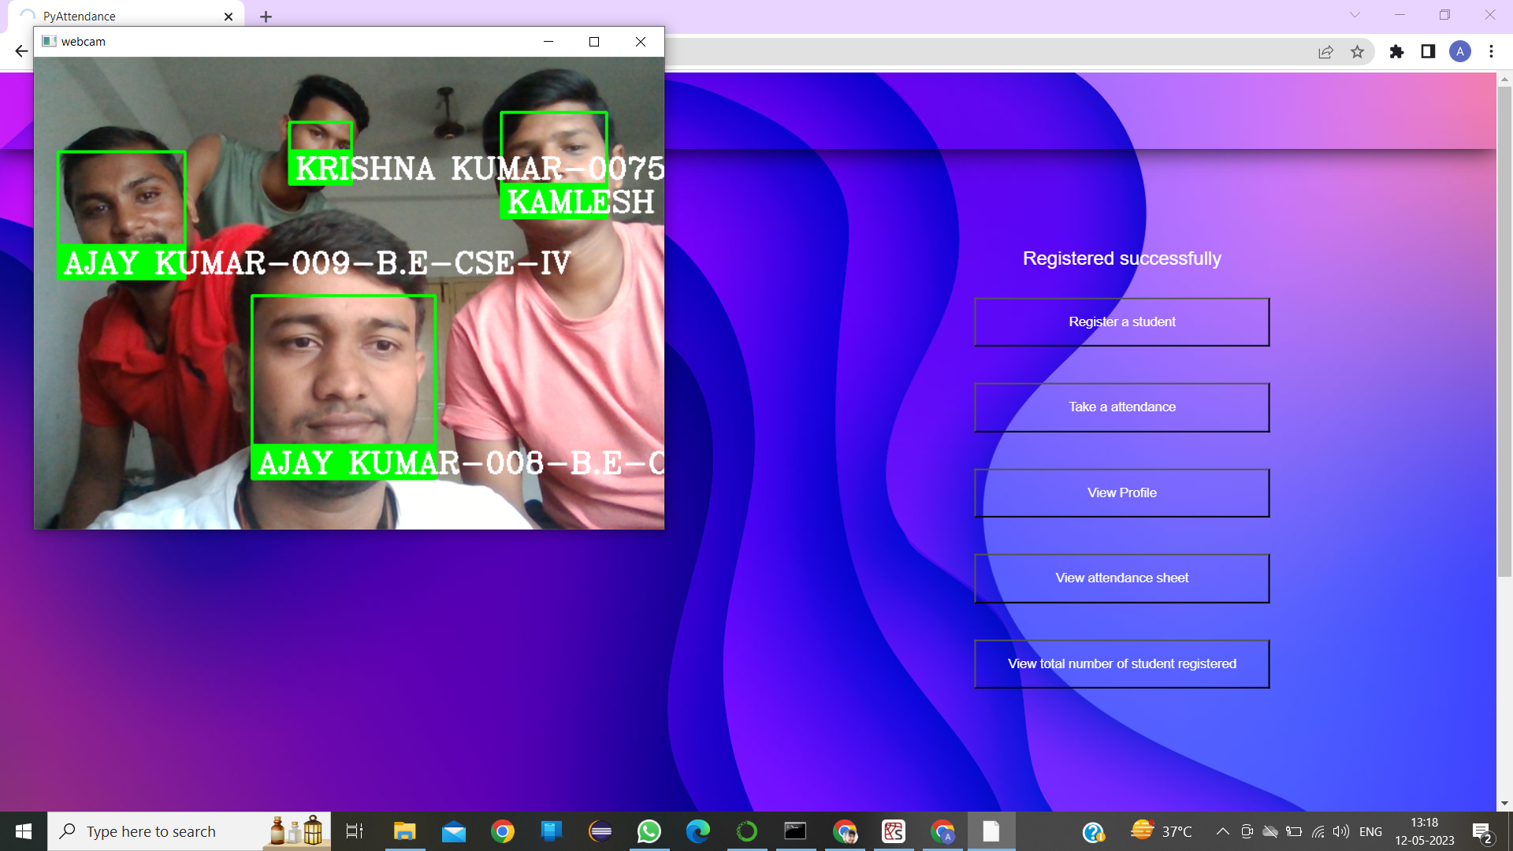
SCREENSHOTS
TAKING MULTIPLE ATTENDACE:
DHANALAKSHMI SRINIVASAN COLLEGE OF ENGINEERING AND TECHNOLOGY DEPARTMENT OF CSE

Slide 12
CONCLUSION AND FUTURE ENHANCEMENTS
CONCULUSION
There are many loopholes in the process of taking attendance using the old method which caused many troubles to most of the institutions.
Therefore, the facial recognition feature embedded in the attendance monitoring system can not only ensure attendance to be taken accurately and also eliminated the flaws in the previous system.
FUTURE ENHANCEMENT
At the same time grants a certain amount of leniency in the attendance calculation, but There is always scope for improvement.
Face recognition techniques are not completely accurate, and the system may sometimes be unable to identify students.
For more reliability of staff to take attendance we will create it as Android App later, and build one more app which given to their parents which can help to monitor their kids attendance from home
DHANALAKSHMI SRINIVASAN COLLEGE OF ENGINEERING AND TECHNOLOGY DEPARTMENT OF CSE

Slide 13
REFERENCES
[1] “Real-Time Smart Attendance System using Face Recognition Techniques”( Shreyak Sawhney; Karan Kacker; Samyak Jain; Shailendra Narayan Singh; Rakesh Garg, 29 July 2019)
[2] “Student Attendance System using Face Recognition” (Samridhi Dev; Tushar Patnaik, 07 October 2020)
[3] “Face Recognition Based Smart Attendance System” (A Arjun Raj; Mahammed Shoheb; K Arvind; K S Chethan, 2020)
[4] “Face Recognition Attendance System Based on Real-Time Video Processing”( Hao Yang; Xiaofeng Hank, 2020)
[5] “Automatic Attendance System using Face Recognition” (Susanta Kumar Sarangi; Arunesh Paul; Harshit Kishor; Kritath Pandey, 21 December 2021)
[6] “AttenFace: A Real Time Attendance System Using Face Recognition” (Ashwin Rao, 14 Nov 2022)
DHANALAKSHMI SRINIVASAN COLLEGE OF ENGINEERING AND TECHNOLOGY DEPARTMENT OF CSE

Slide 14
THANK YOU
DHANALAKSHMI SRINIVASAN COLLEGE OF ENGINEERING AND TECHNOLOGY DEPARTMENT OF CSE

